Slide 1

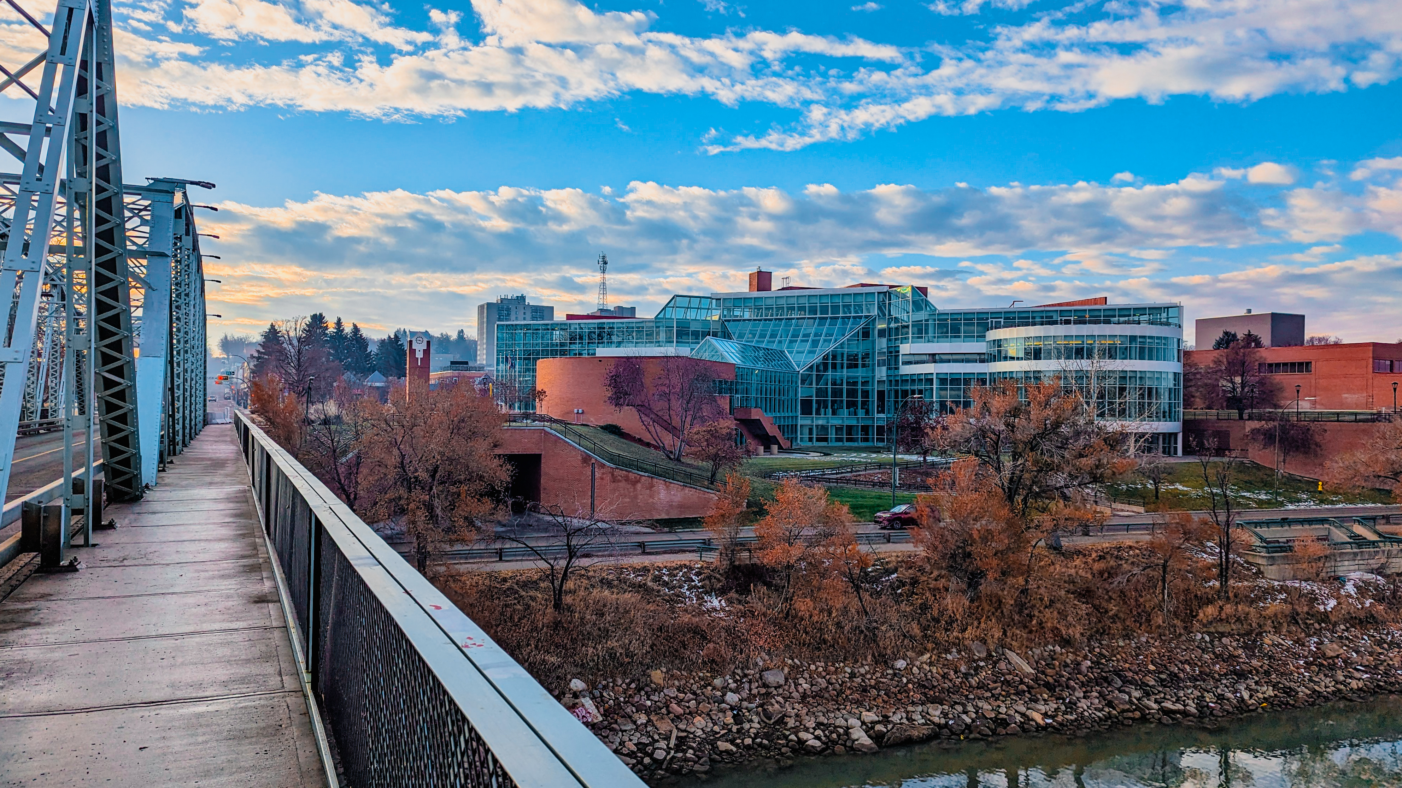


Professional Involvement and Schedules
A Guide to the Requirements of the National Building Code – 2023 Alberta Edition
Professional Involvement and Schedules under NBC(AE) 2023
May 27, 2026

Slide 2

Introduction
About me:
Diploma from SAIT in Architectural Technologies in 1992
30+ years experience as an A.T., Draftsperson and Job Captain
Certified as a BSCO for Part 9, Part 3 and HVAC-All
Joined City of Medicine Hat as a BSCO in April 2024
About City of Medicine Hat Safety Codes Services:
Nine Safety Codes Officers (SCO’s):
  Building
  HVAC
  Plumbing
  Gas
  Private Sewage
  Electrical
Supported by Development Technicians and Management

Slide 3
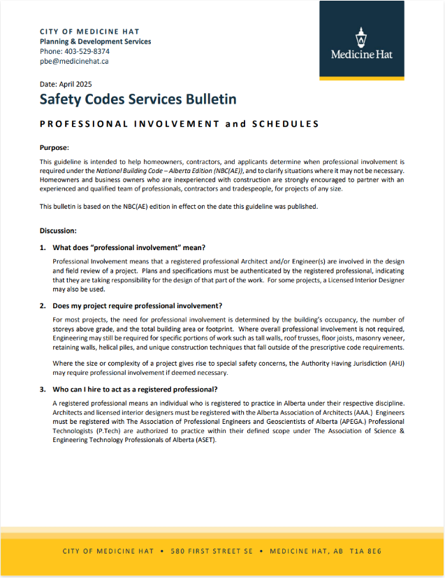
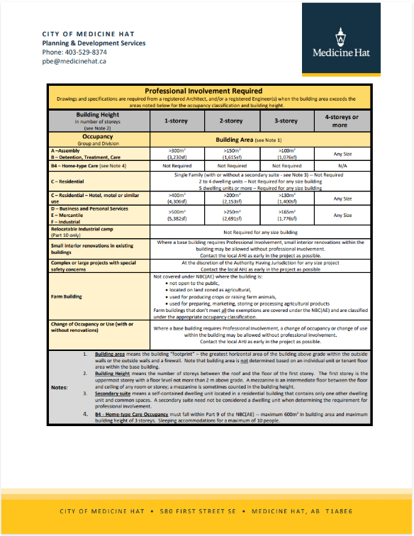

What does “Professional Involvement” mean?
An easy-to-understand guide to Professional Involvement and Schedules:
Full guide is available on the City of Medicine Hat website:

Slide 4
What does “Professional Involvement” mean?
Professional Involvement means that a registered professional is retained to take responsibility for the design and field reviews for their scope of work within the project.
Architects registered with AAA
Licensed Interior Designers – defined scope under AAA
Engineers registered with APEGA
Professional Technologists (P.Tech) – defined scope under ASET
Professionals may be fully involved for the overall project or may be limited to specific scopes of work.

Slide 5
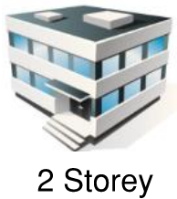



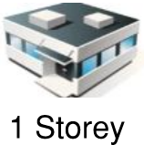
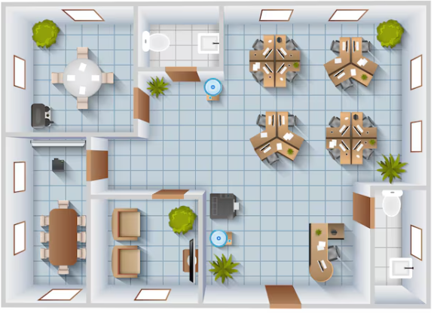






Does my project require Professional Involvement?
Three main criteria that determine Professional Involvement:
Occupancy / Use
Number of Storeys
Building Area (footprint)
* Exception: Multi-family residential is based on number of dwellings

Slide 6
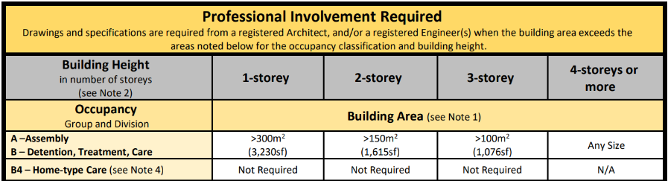
Does my project require Professional Involvement?
Group A – Assembly
Group B – Detention, Treatment, Care and B4-Home-type Care

Slide 7
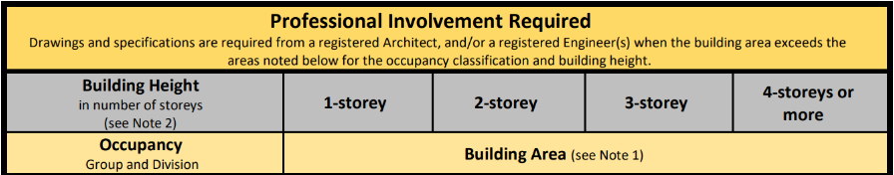

Does my project require Professional Involvement?
Group C – Residential

Slide 8
Does my project require Professional Involvement?
Group D – Business and Personal Services
Group E – Mercantile
Group F - Industrial

Slide 9
Exemptions and Special Cases:
Relocatable industrial camps – not required for any size of building
Farm buildings – not covered under NBC(AE) where the building is:
  Located on land zoned as Agricultural
  Not open to the public
  Used for producing crops or raising farm animals
  Used for preparing, marketing, storing or processing agricultural products
Small interior renovations in existing buildings – at the discretion of the A.H.J.
Change of Occupancy or Use (with or without renovations) – at the discretion of the A.H.J.

Slide 10
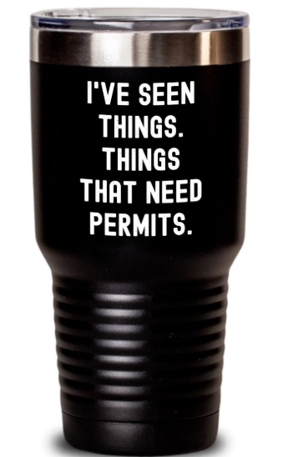
Components and Systems that require Engineering:
Some components and systems require professionals regardless of overall professional involvement:
Specific components:
  Tall Walls
  Helical (Screw) Piles
  Preserved Wood Foundations
  Steel Building Systems
  Pre-Engineered Roof Trusses
  LVL Beams
  Adhered Masonry Veneer
  Structural Insulated Panels (SIP’s)
  Retaining Walls over 1.2m (4-feet)
Life-safety systems:
  Automatic Sprinkler Systems
  Commercial Cooking Fire Suppression
  Fire Alarm Systems
Size, complexity, special safety concerns:
  Tents and Air Supported Structures
  Unique construction techniques that fall outside of the prescriptive code
  At the discretion of the A.H.J.

Slide 11
Defined Roles Under NBC(AE) and Schedules:
Coordinating Registered Professional (CPP):
Coordinates the design and field reviews of the RPR’s.
Submits Schedule A with the building permit application.
Submits Schedule C-1 at the completion of the project prior to occupancy.
Registered Professional of Record (RPR):
Responsible for design and field reviews in their discipline:
Architectural / Licenced Interior Design
Structural
Mechanical
Electrical
Geotechnical
Submits Schedule B with the building permit application.
Submits Schedule C-2 to the CRP and AHJ (if requested.)
Delegated Registered Professional (DRP):
Responsible for work delegated under the RPR.
Example: Helical Screw Pile Foundation
Submits Schedule C-3 to the RPR and the AHJ (if requested.)

Slide 12

Common Errors and Setbacks:
Work that requires an Engineer’s design has not been Engineered
As-built conditions at an inspection don’t match the stamped drawings
Schedules are missing information (stamps, signatures, etc.)
Schedules are missing delegated work under the section for ‘Schedule C-3’
Change or termination of a professional during the project
  Schedule C’s must be submitted by the same professionals that submitted Schedule A and B’s
Schedules not submitted prior to the final inspection

Slide 13
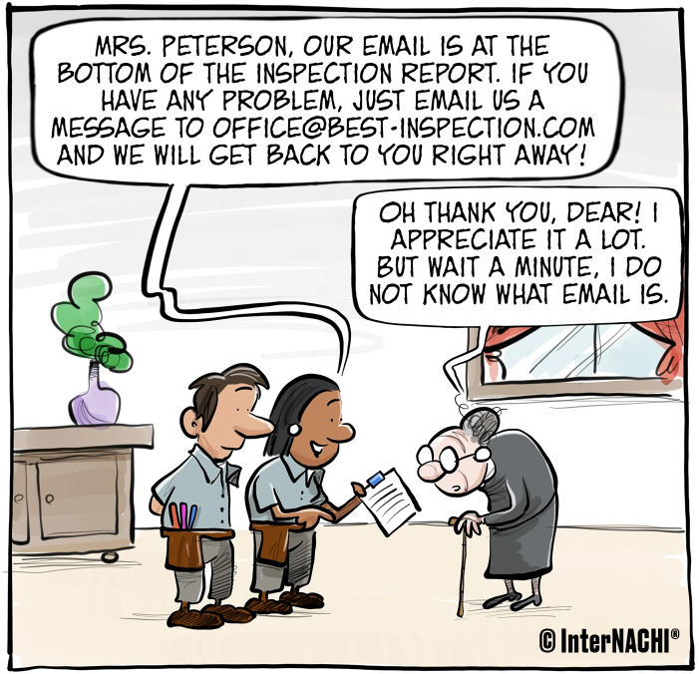

Conclusion:
Thank you for your time and attention!
Questions?
Safety Codes Services is available to provide guidance and expertise – please feel free to reach out at any time.

